Slide 1
Creating a BCeID and Registering with Student Transcripts
If you already have a BCeID account go to: www.studenttranscripts.gov.bc.ca and login with your ID
If you do not have a BCeID account, you must create an account before registering with Student Transcripts (www.bceid.ca → register for a Basic BCeID) or follow link on MSS website.

Slide 2
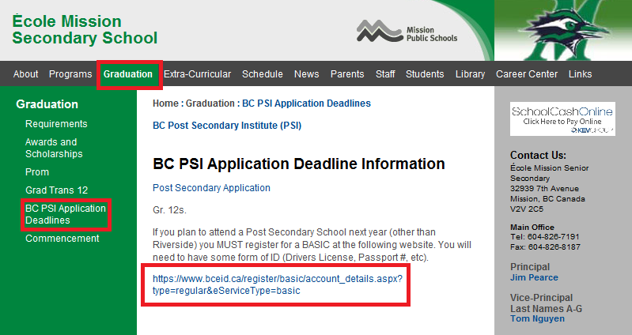
Once you have opened up your internet browser, go to www.mss.mpsd.ca
Click the graduation tab → BC PSI Application Deadlines → Click the link below

Slide 3
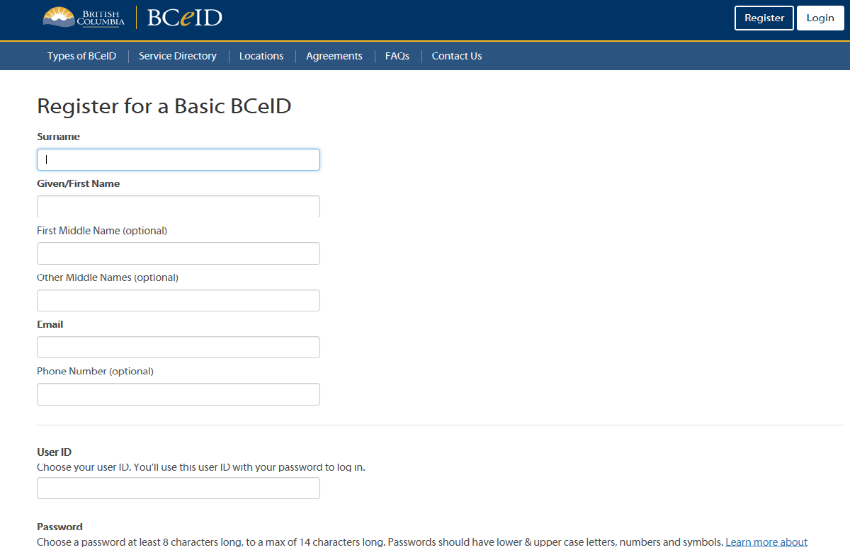

Slide 4
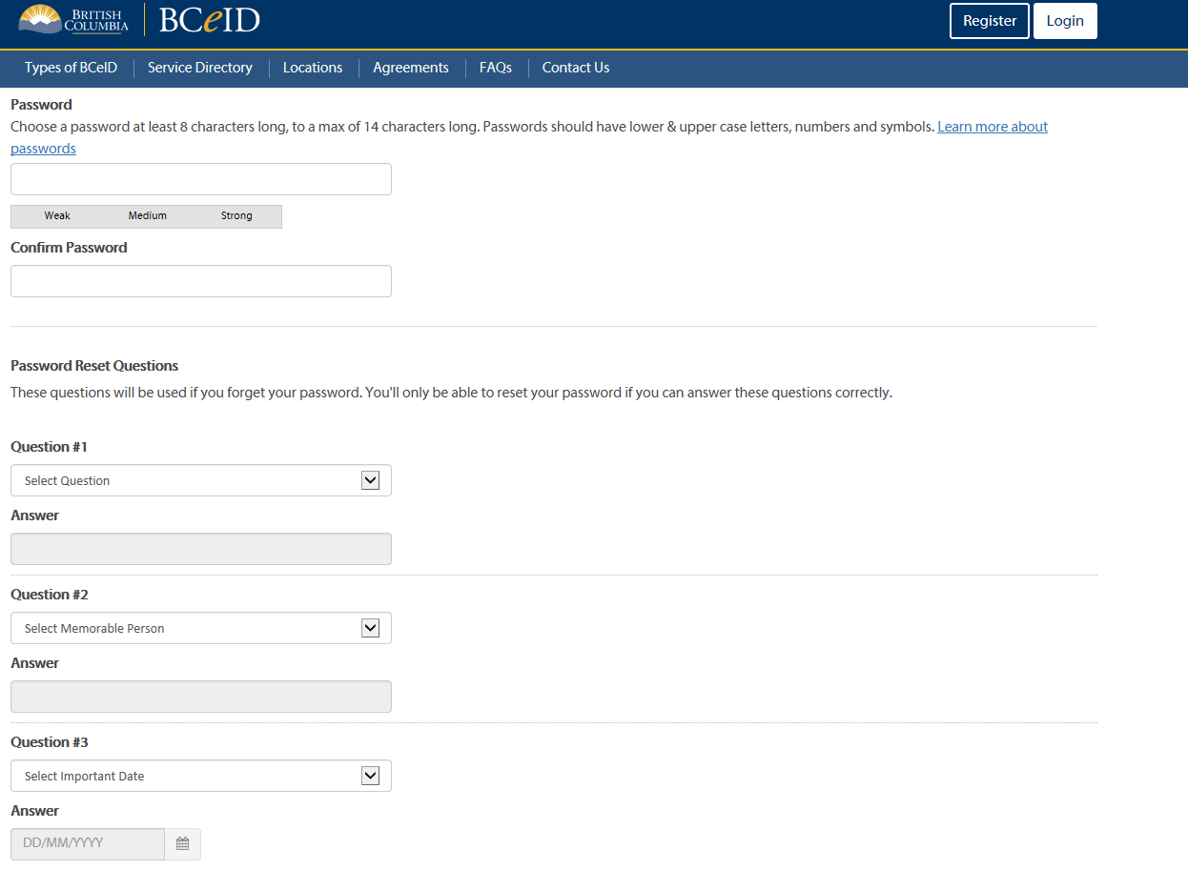

Slide 5
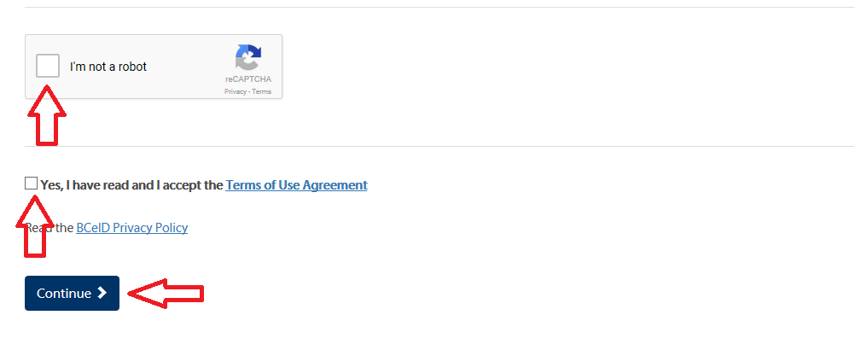

Slide 6
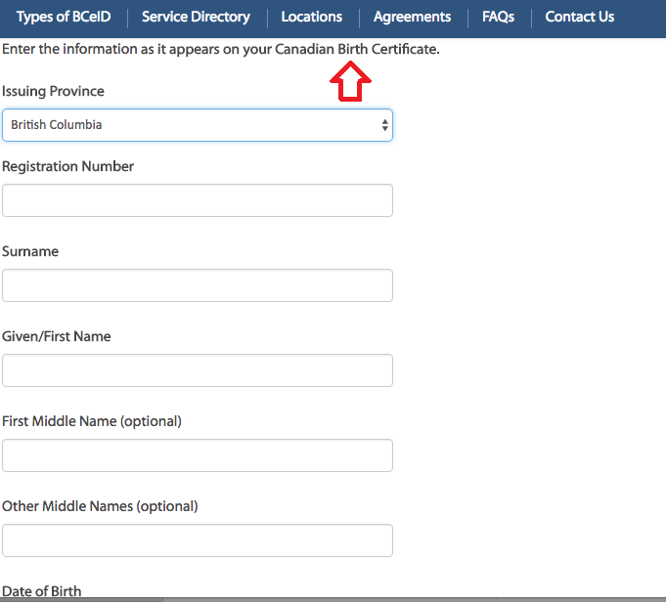

Slide 7
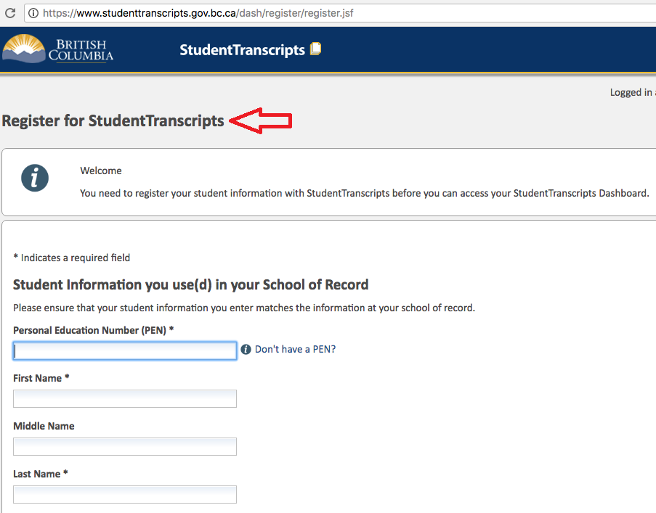
Next step: Register for StudentTranscripts. (Service Directory Page 7 or visit link below)
www.studenttranscripts.gov.bc.ca

Slide 8
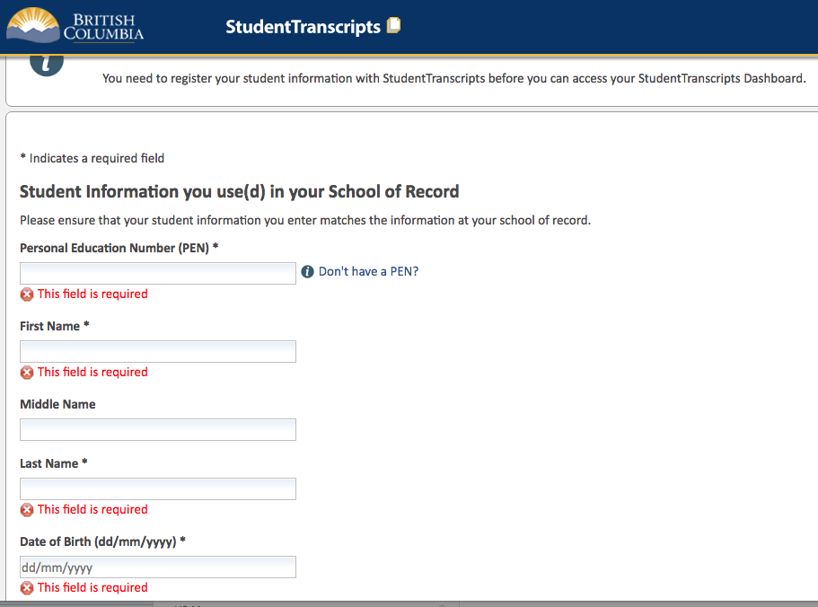

Slide 9
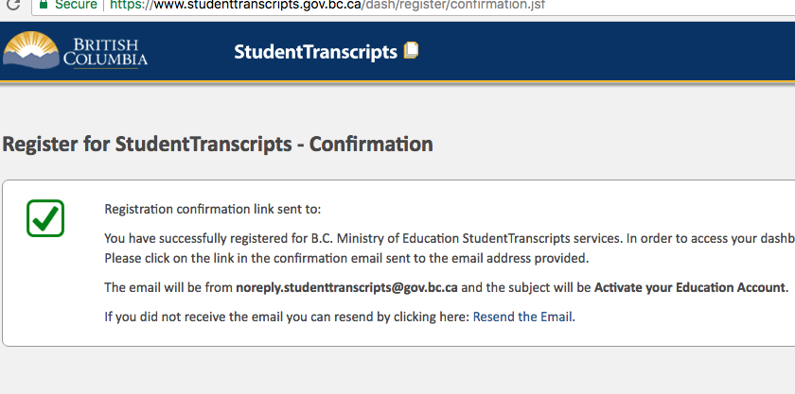

Slide 10
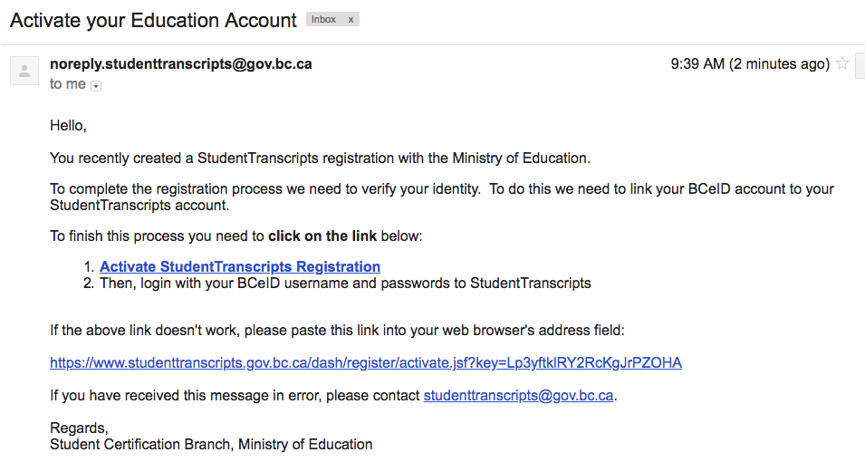
Example of Confirmation Email sent to your account

Slide 12
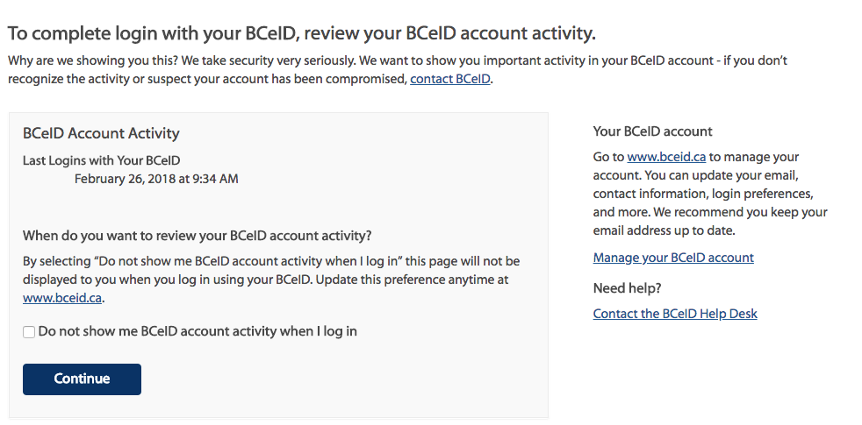

Slide 14
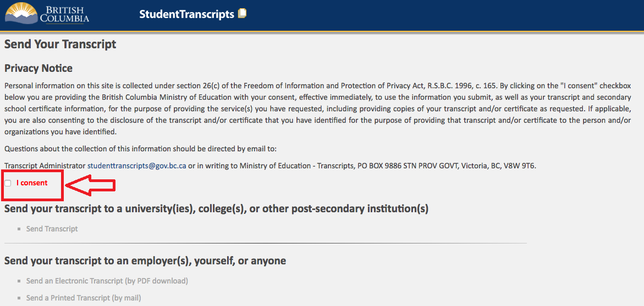

Slide 15
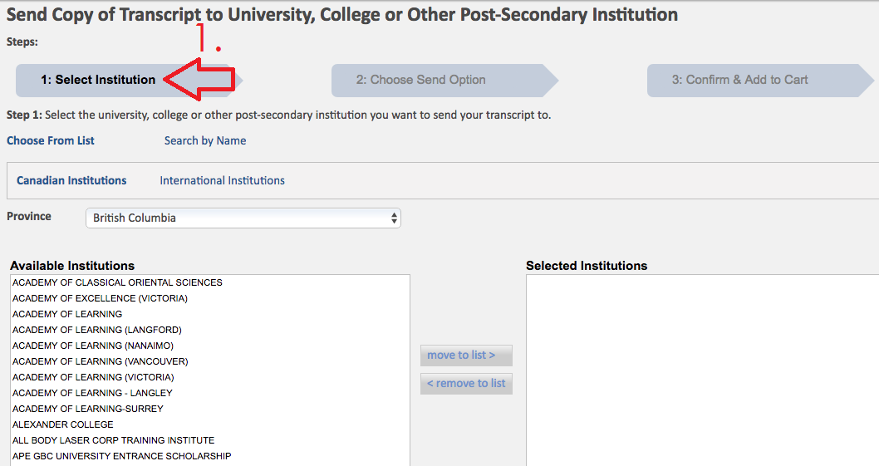

Slide 16
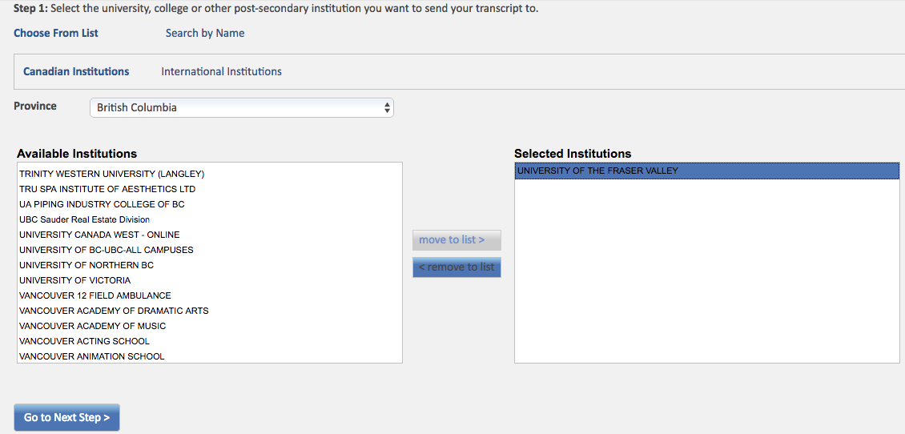
Select Post-Secondary Institutions you wish to send a transcript to

Slide 17
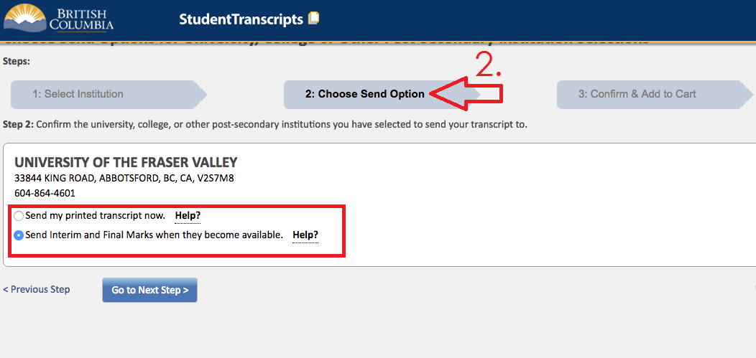

Slide 18
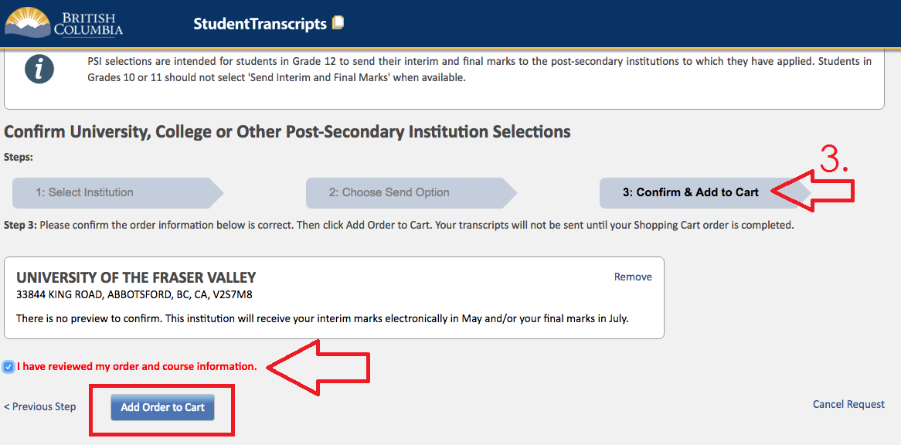

Slide 19
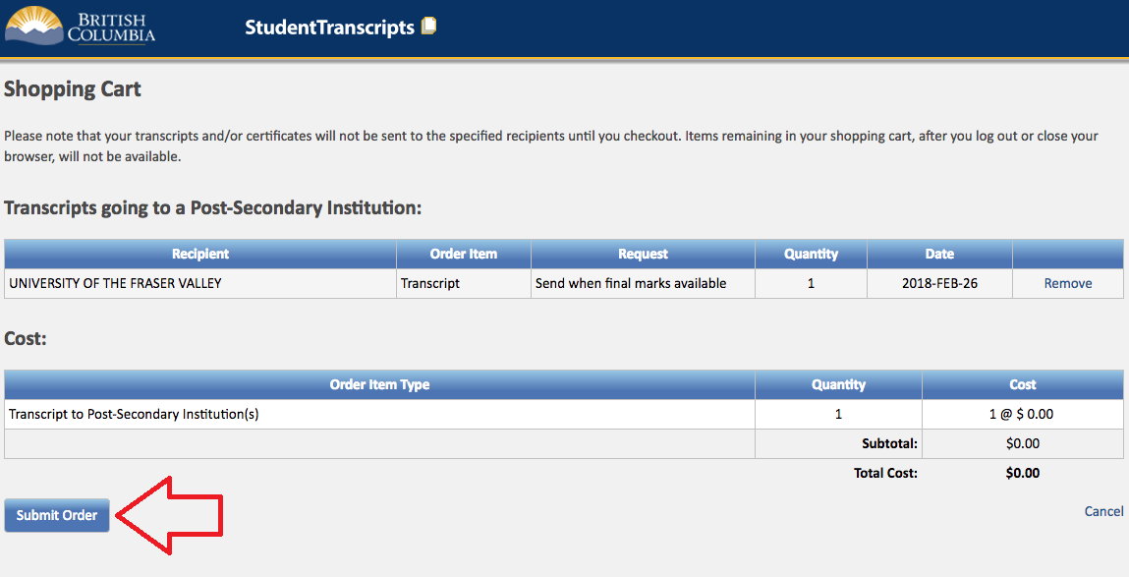

Slide 20
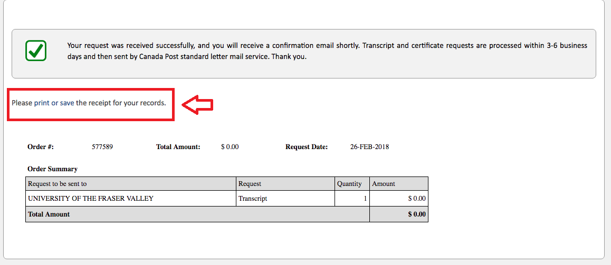
Print or save the transcript receipt for your records.

Slide 21
THE END! ☺

